Slide 1
ET0023 Operating Systems
5. Process Management &
Scheduling

Slide 2
Process Management & Scheduling
In a multiprogramming or multitasking system processes will be competing for
System resources
Memory
Files (I/O devices)
OS has to manage these resources in a fair and efficient manner
OS has to provide for Process Management & Scheduling

Slide 3
Process Creation
To create a new process, the OS has to
Name the process
Create a new Process ID and Process Control Block
Locate the program to be executed on disk and allocate memory for the code segment in RAM
Load the program into code segment, initialize PCB registers
Prioritize the process (default values)
Schedule the process for execution.

Slide 4
Process Creation
Using CLI to create a process, new process becomes child of the command interpreter.
Processes form a hierarchy and are linked by a tree structure.
If Parent is signalled or killed, usually all Children received the same signal and are destroyed together with parent.
When a Child is created, the process may
Duplicate the Parent process
Load a completely new program
The Parent may also
Continue executing along side its Children
Wait for some/all to finish before proceeding

Slide 5
Process Hierarchies
Root Node
Child #1
Child #2
Child #3

Slide 6
Process Termination
The process after creation, starts running and completes its job.
The process must now terminate.
Termination is usually one of the following
Normal exit (voluntary)
Error exit (voluntary)
Fatal error (involuntary)
Killed by another process (involuntary)

Slide 7
Process Scheduling
To keep the CPU as busy as possible, the OS must perform scheduling.
When a process blocks, it should be replaced.
To let a process run for a maximum amount of time, an interrupt must be in place.
Any stopped process must have its PCB saved and the next PCB restored.
Process switching is expensive, hence the scheduler must be efficient.

Slide 8
CPU-I/O Burst Cycle
All processes alternate bursts of computing (CPU cycles) with I/O requests.
I/O wait is when a process enters the blocked state waiting for an external device to complete its work.
CPU-bound: processes that use more time computing
I/O-bound: processes that use more time waiting for I/O

Slide 9
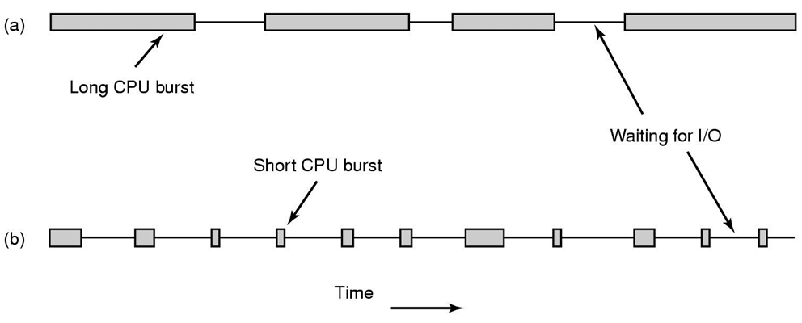
How does a Process behave?
Bursts of CPU usage alternate with periods of IO wait
(a) A CPU-bound process
(b) An IO-bound process

Slide 10
Example
CPU Burst
I/O Burst
cout << "Enter sides: ";
cin >> a >> b >> c;
if (a == 0) {
cout << "Error!";
return -1;
}
sqrv = b*b - 4*a*c;
root1 = (-b + sqrv) / 2*a;
root2 = (-b - sqrv) / 2*a;
cout << "Root1 = " << root1;
cout << "Root2 = " << root2;
I/O Cycle
CPU Cycle
I/O Cycle

Slide 11
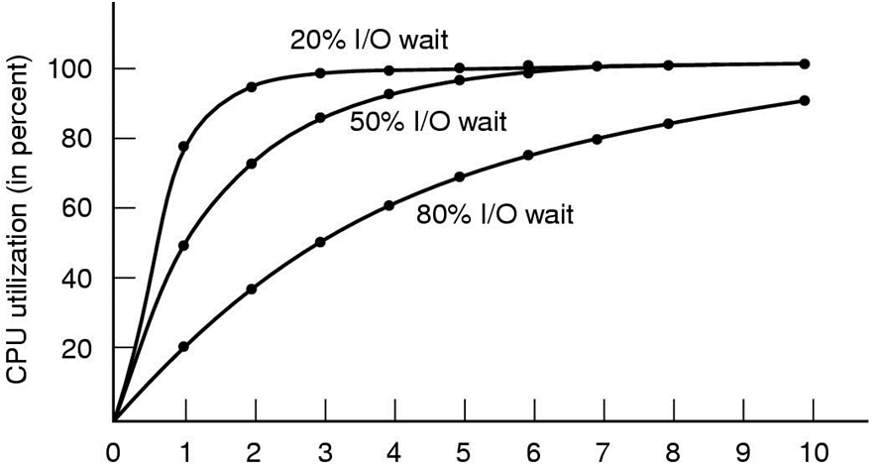
Modelling Multitasking
(CPU-bound process)
(I/O-bound process)
Degree of multi-tasking
CPU utilization as a function of number of processes in memory

Slide 12
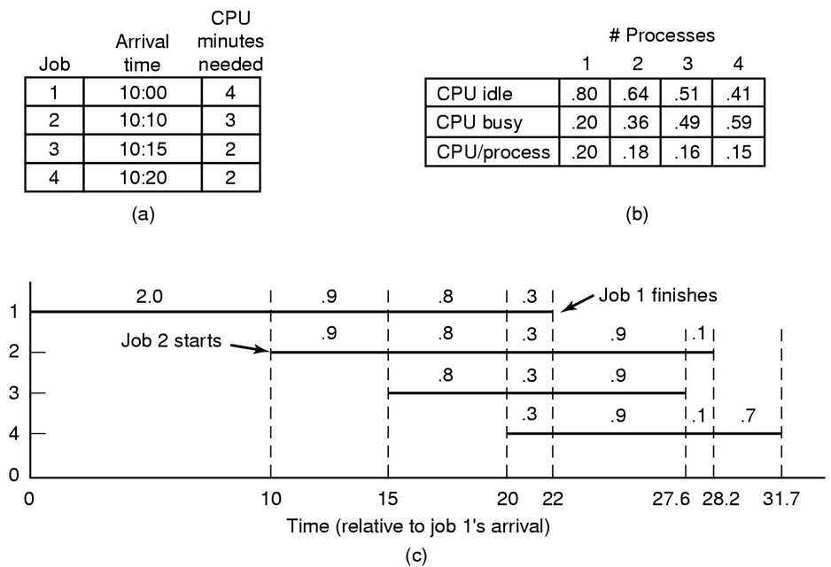
Analysis of Multi-Tasking Performance
Notes:
From time 0 to 10 min, there are only 1 process running, CPU time allocated to each process = 0.2 * 10 = 2 min.
From time 10 to 15 min, there are 2 processes running, CPU time allocated to each process = 0.18 * 5 = 0.9 min.
From time 15 to 20 min, there are 3 processes running, CPU time allocated to each process = 0.16 * 5 = 0.8 min.
From time 20 to 22 min, there are 4 processes running, CPU time allocated to each process = 0.15 * 2 = 0.3 min.
Note: Process 1 completes at time 22 min. Process 1 has its shares of the required 4 min of CPU time.
From time 22 to 27.6 min, there are 3 processes running, CPU time allocated to each process = 0.16 * 5.6 = 0.9 min.
Note: Process 3 completes at time 27.6 min. Process 3 has its shares of the required 2 min of CPU time.
From time 27.6 to 28.2 min, there are 2 processes running, CPU time allocated to each process = 0.18 * 0.56 = 0.1 min.
Note: Process 2 completes at time 28.2 min. Process 2 has its shares of the required 3 min of CPU time.
From time 28.2 to 31.7 min, there is only 1 process running, CPU time allocated to each process = 0.2 * 0.35 = 0.7 min.
Note: Process 4 completes at time 31.7 min. Process 4 has its shares of the required 2 min of CPU time.

Slide 13
Process Scheduling Policy
An algorithm the Policy Scheduler uses to determine
How much CPU time does a process get
Who gets the process next (Priority)
When the process will be interrupted

Slide 14
Scheduling Criterion
CPU Utilization: Objective to keep CPU as busy as possible
Throughput: How many processes are completed per time unit
Turnaround time: How long it takes to execute a process (from submission to completion)
Waiting time: The time a process has to wait before execution starts
Response time: Time from submission to obtaining the first results

Slide 15
Example
Four processes are submitted at time 0
P1
P2
P3
P4
P2
P3
0
1
2
3
4
5
6
7
8
9
10
P1 | Waiting time | 0
 | Turnaround time | 3
P2 | Waiting time | 3 + 3 = 6
 | Turnaround time | 9
P3 | Waiting time | 4 + 4 = 8
 | Turnaround time | 10
P4 | Waiting time | 5
 | Turnaround time | 7
Average waiting time | (0+6+8+5)/4 = 4.75
Average turnaround time | (3+9+10+7)/4 = 7.25

Slide 16
Process Scheduling Policy
A good algorithm should
Maximize throughput
Minimize response time
Minimize turnaround time
Minimize waiting time
Maximize CPU efficiency
Ensure fairness for all processes

Slide 17
Process States
new
terminated
admitted
1
exit
dispatch
ready
running
interrupt
2
4
I/O or Event wait
I/O or Event completion
3
waiting
1 Scheduler picks this process
2 Scheduler picks another process
3 Process blocks for input
4 Input becomes available

Slide 18
Scheduling Algorithms
A non-preemptive scheduling algorithm picks a process to run and then just lets it run until it blocks (either on IO or waiting for another process) or until it voluntarily releases the CPU.
Does not require a clock.
A preemptive scheduling algorithm picks a process and lets it run for a maximum of some fixed time. If it is still running at the end of time interval, it is suspended and the scheduler picks another process to run (if one is available).
Requires a clock.

Slide 19
Scheduling Environments
Different environments require different scheduling algorithms
Batch Background
Interactive Foreground
Realtime Multimedia
There is no one size fits all!

Slide 20
Scheduling Goals
All systems
Fairness – giving each process a fair share of the CPU
Policy enforcement – seeing that stated policy is carried out
Balance – keeping all parts of the system busy
Batch systems
Throughput – maximize jobs per hour
Turnaround time – minimize time between submission and termination
CPU utilization – keep the CPU busy all the time
Interactive systems
Response time – respond to requests quickly
Proportionality – meet user’s expectations
Real-time systems
Meeting deadlines – avoid losing data
Predictability – avoid quality degradation in multimedia systems

Slide 21
The “Perfect” Scheduler
Minimize Latency
Response/Job completion time
Maximize Throughput
Maximize job/time
Maximize Utilization
Keep all devices busy
Fairness
Every job makes progress, no job starves

Slide 22
Problem Analogy
Imagine you are the cook at a “Chi Char” stall
Customers continually enter and place their orders
Dishes take varying amounts of time to prepare
What is your goal?
What strategy achieves your goal?

Slide 23
“Chi Char Stall” vs Multitasking
Chi Char Stall
Waitress
Cook
Client
Order
Dish
Multi-tasking OS
CPU Scheduler
CPU
User
Process
CPU or I/O Burst

Slide 24
CPU / I-O Burst
A Process alternates between CPU and I/O Bursts
CPU bound: Long CPU bursts
Matrix Multiply
I-O bound: Short CPU bursts
Word Processor software
During an I/O burst = process is idle, switch to another “for free”

Slide 25
CPU Scheduler
Processes and Threads migrate among queues (Ready, Device Wait, Run)
Scheduler selects one from the ready queue to run
Which one?
When?
new
terminated
admitted
1
exit
dispatch
ready
running
interrupt
4
2
I/O or Event wait
I/O or Event completion
3
waiting

Slide 26
First Come First Served
Jobs are scheduled in order of arrival
Non-preemptive
Problem: Average wait time depends on arrival order
P1 16
P2 4
P3 5
P4 5
Arrival order: P1,P2,P3,P4
I
P1 | P2 | P3 | P4
0
16
20
25
30
Arrival order: P3,P4,P2,P1
II
P3 | P4 | P2 | P1
0
5
10
14
30
Advantage: Really Simple!!
Notes:
Case I: Average turnaround time = (16 + 20 + 25 + 30)/4 = 22.75 (min)
Average waiting time = (0 + 16 + 20 + 25 ) / 4 = 15.25
Case II: Average turnaround time = (5 + 10 + 14 + 30)/4 = 14.75 (min)
Average waiting time = (0 + 5 + 10 + 14 ) / 4 = 7.25
In FCFS, the average turnaround time is dependent upon the arrival order of processes.

Slide 27
Batch Systems
As jobs arrive at the system, they are initially placed in an input queue stored on the disk.
The admission scheduler decides which jobs to admit to the system.
The memory scheduler determines which processes are kept in memory and which on the disk.
The CPU scheduler picks one of the ready processes in main memory to run next.

Slide 28
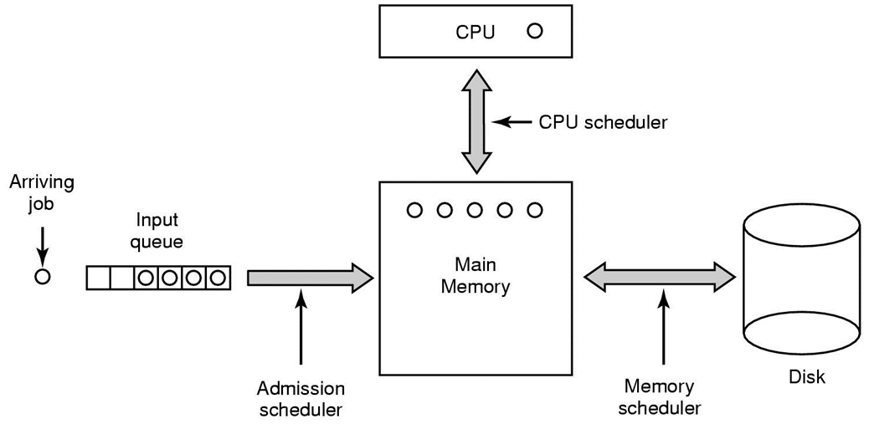
Scheduling in Batch Systems

Slide 29
Last-In-First-Out ?
Newly arrived jobs are placed at the head of ready queue.
Improves response time for newly created jobs
Problem:
May lead to starvation (early processes may never get any CPU time!)

Slide 30
Round Robin
FCFS with preemption
Often used for timesharing
Ready queue is treated as a circular queue (FIFO)
Each process is given a time slice (quantum)
Process runs for the quantum or until blocked
RR allocates the CPU uniformly (fairly) across participants
If average queue length is n, each quantum is 1/n

Slide 31
Round Robin
Process Burst Time (sec)
P1 53
P2 17
P3 68
P4 24
Time Quantum = 20
0 | 20 | 40 | 60 | 80 | 100 | 120 | 140 | 160
P1 | P2 | P3 | P4 | P1 | P3 | P4 | P1 | P3
P2 completes
P4 completes
P1 completes
Notes:
Average turnaround time = (P1 + P2 + P3 + P4 completion time) = (134 + 37 + 162 + 121)/4 = 454/4 = 113.5 sec

Slide 32
RR: Choice of Time Quantum
Performance depends on length of time-slice
Context switching is not free
If time-slice is set too high
FCFS
Process will finish or block before their slice is up
If time-slice is set too low
Overhead is on the context switching between processes
Usual Practice
Context switch is usually negligible (<1% per timeslice)
Context switch too often – lose all productivity

Slide 33
Shortest Job First
Choose the job with the shortest next CPU burst.
Optimal for minimizing average meeting time
Problem: Impossible to know the length of next CPU burst.
P1 16
P2 4
P3 5
P4 5
Arrival order: P1,P2,P3,P4
P1 | P2 | P3 | P4
16
20
25
30
Arrival order: P2,P3,P4,P1
P2 | P3 | P4 | P1
4
9
14
30
Notes:
Case FCFS: Average turnaround time = (16 + 20 + 25 + 30)/4 = 22.75 (min)
Case SJF: Average turnaround time = (4 + 9 + 14 + 30)/4 = 14.25 (min)

Slide 34
Preemptive Shortest Job First
SJF can be preemptive or non-preemptive
When new job arrives and current job has long time to execute.
Preemptive SJF = Shortest Remaining Time First (SRTF)
P3
Running Queue:
P2
P1
0
4
20
Running Queue:
P2
P1
P3
P1
0
4
8
10
20

Slide 35
Priority Scheduling
Choose next job based on priority
For SJF, priority = expected CPU burst
Can be preemptive or non-preemptive
Can approximate to other scheduling algorithms
P (arrival time) FIFO
P (now – arrival time) LIFO
P (job length) SJF
Problem:
Starvation: jobs can wait indefinitely
Solution: Age processes, increase priority as a function of waiting time.

Slide 36
Priority Scheduling
Can use external characteristics of the process to assign priorities
Position of user (e.g. root/sysadmin)
Cost ($$$ - he who pays gets first)
Can use internal characteristics of the process to assign priorities
Memory requirements
Number and type of peripheral devices
Estimated CPU time
Amount of time already spent in the system

Slide 37
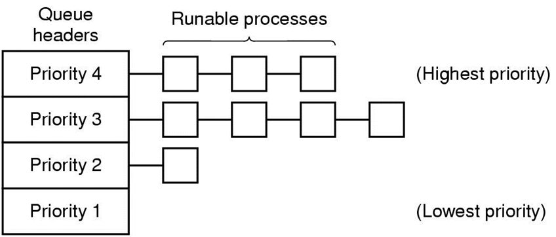
Priority Scheduling using Multiple Queues
Each process is assigned a priority, and the runnable process with the highest priority is allowed to run.
Idea used by Windows and Linux.

Slide 38
Multilevel Queue Scheduling
Highest Priority
System Process
Interactive Process
Batch Process
Student Process
Lowest Priority

Slide 39
Multilevel Queue Scheduling
Implement multiple ready queues based on job "type"
System processes
Interactive processes
Student programs
CPU-bound processes
Batch jobs
Different queues may be scheduled using different algorithms
Intra-queue CPU allocation is either strict or proportional
Problem: classifying jobs into queues is difficult.

Slide 40
Multilevel Feedback Queues
Highest Priority
Quantum = 2
Quantum = 4
Quantum = 8
FCFS
Lowest Priority

Slide 41
Multilevel Feedback Queue
Implement multiple ready queues
Different queues may be scheduled using different algorithms
Similar to multilevel queue scheduling but assignments are not static
Jobs move from queue to queue based on feedback
Feedback = Behaviour of the job
e.g. full quantum for computation, or frequent I/O
Very general algorithm, select parameters for
Number of queues
Scheduling algorithm for each queue
When to upgrade or downgrade a job

Slide 42
A Multi-level System
I/O bound jobs
Priority
CPU bound jobs
Time-slice

Slide 43
Real-time Scheduling
Real-time processes have timing constraints, Expressed as
Deadlines
Rate requirements
Common misconception:
Real time does not mean fast.

Slide 44
Real-time Scheduling
Common RT scheduling policies
Rate monotonic
Just one scalar priority related to productivity of job
Priority = 1/rate
Static
Earliest Deadline First (EDF)
Dynamic but more complex
Priority = Deadline
Both require admission control to provide guarantees

Slide 45
Real-Time System Scheduling
Hard real-time
There are absolute deadlines that must be met, or else!
Soft real-time
Missing an occasional deadline is undesirable, but
nevertheless tolerable.

Slide 46
Thread Scheduling
All thread share code & data segment
Option 1: Ignore this fact
Option 2: Two-level scheduling
User-level scheduling
Schedule process, and within each process, schedule threads
Reduce control switching overhead and improve cache hit ratio

Slide 47
Multiprocessor Scheduling
Option 1: Ignore this fact
Option 2: Space based affinity
Assign threads to processes
Control resource sharing
Option 3: Gang scheduling
Run all threads belonging to a process at the same time
Low-latency communication
Greater distance (scheduling)

Slide 48
Problem Cases
Blindness about job types
I/O goes idle
Optimization involves favouring jobs of type "A" over "B"
Lots of "A"s, then "B" starve
Interactive process trapped behind others
Response time suffers for no reason
Priorities: A depends on B, A's priority > B's
B's never run

Slide 49
Convoy Effect
CPU bound job will hold CPU until done, or it causes an I/O burst (rare)
Long periods where no I/O requests are issued, CPU is held
Result: Poor I/O device utilization
Example: One CPU bound, many I/O bound
CPU-bound runs, I/O devices idle
CPU-bound blocks
I/O bound job(s) run, quickly blocks on I/O
CPU-bound runs again
I/O completes
CPU-bound still runs while I/O devices idle

Slide 50
QUESTIONS

